Slide 1
Using Data Science to Advance Cancer Research
By Kaitlyn Torres and Charles Howard

Slide 2
Table of contents
01
02
03
04
Introduction
Methodology
Introduces Data Science and its uses and importance pertaining to the healthcare field
Describes the methods and processes used to extract and analyze data
Results analysis
Conclusions
Findings for United States, New York, and Florida
Key takeaways from this Project and Future Steps

Slide 3
1
Introduction
The Story Behind Our Research

Slide 4
What is the Purpose of our Project?
GOAL:
show how data science advances cancer research
HOW:
We will be using data science and data visualization techniques to collect and analyze incidence of different types of cancer in the United States, focusing primarily on New York and Florida.
RESULT:
We can identify patterns and anomalies in the data to understand the reasons behind the high prevalence of a specific type of cancer in a particular region.

Slide 5
What is Data Science
Purpose:
Find evidence that supports or challenges a hypothesis.
How?
analyze data to find patterns, anomalies, and/or correlations between different types of information
ex: predictive modeling, statistical analysis, clustering, etc…

Slide 6
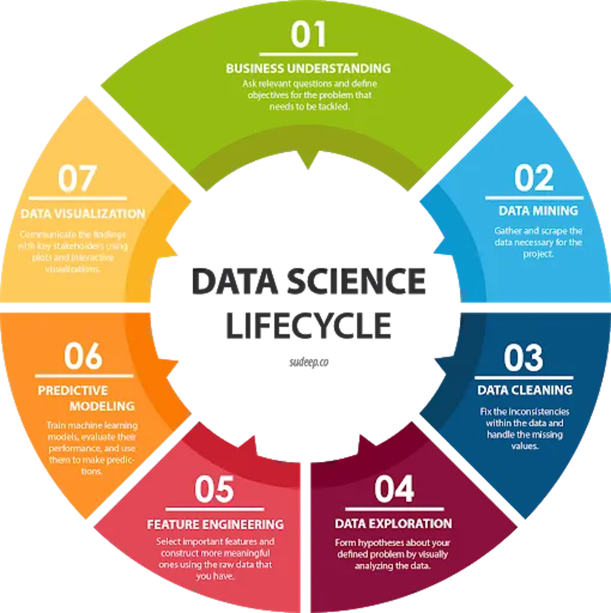

Slide 7




The Rise of Data Science
Once only prevalent in technical fields, data science has emerged in a variety fields that include but are not limited to:
Education
Finance
Marketing
HEALTHCARE

Slide 8
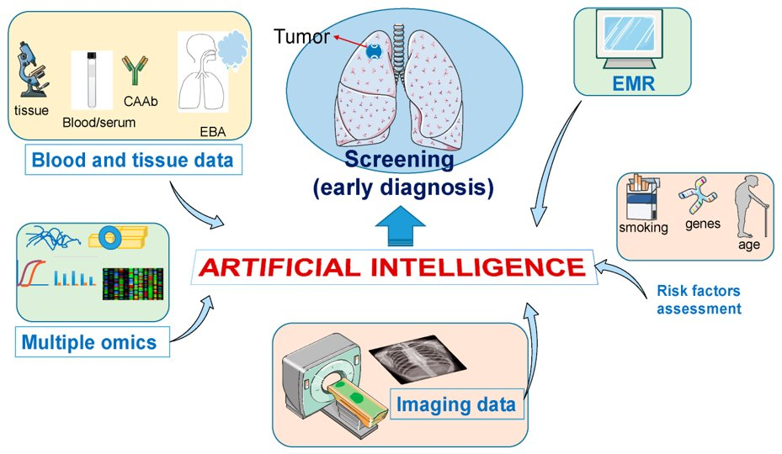
Data Science in Healthcare
Benefits:
Better diagnostics
Early detection of issues
Used to help and diagnose patients virtually
Usage:
Discover new drugs using Artificial Intelligence
Analysis of Medical Imaging (MRIS, CAT)
Disease Tracking and Prevention
Diagnose Cancer at early stages

Slide 9
Data Science Focused on Cancer
Building Capacity for Global Cancer Research: Existing Opportunities and Future Directions
https://www.ncbi.nlm.nih.gov/pmc/articles/PMC8285681/
This paper examines the efforts to address the gaps in global cancer research at the National Institutes of Health.
Low-income and middle-income countries have an increasing cost and labor burden due to cancer.

Slide 10
Data Science Focused on Cancer
Machine Learning and AI in Cancer Prognosis, Prediction, and Treatment Selection: A Critical Approach
https://www.ncbi.nlm.nih.gov/pmc/articles/PMC10312208/
One project that inspired us uses Machine Learning to predict cancer growths, their prognosis, and the treatment recommendation.
Machine learning has been effective in predicting breast, brain, lung, liver, and prostate cancer.

Slide 11
2
Methodology
Steps Taken to Produce Analysis

Slide 12
Python/Jupyter Notebook
Python (Programming Language)
contains a variety of libraries for data analysis, visualization, and machine-learning techniques
Jupyter Notebook:
an open source web application that allows code to be edited, shared, and run in realtime

Slide 13
Data Extraction
To extract data from the sources, two different techniques were used:
Playwright/Beautiful Soup:
Playwright : API that launches a browser instance of a desired webpage
Beautiful Soup : packages that parsing through HTML and grabs desired text
Tabula:
Python package that reads tables in from a pdf
( tabula.read_pdf(pdf_path, pages=3) )

Slide 14

Cleaning up Data
Pandas:
open-source, easy to use package that provides data structures and functionalities for handling numerical tables and time series
Mainly used for data manipulation

Slide 15
Data Visualizations
Plotly: open source python package that is used to create a variety of interactive graphs including bar graphs, scatter plots, and pie charts
Choropleth Map: a map of colored polygons used to represent spatial variations of a quantity
Plotly Express: United States
Figure Factory: Florida/New York

Slide 16

Pandas Data Manipulation
To continue detecting anomalies and patterns, pandas package was used again to manipulate the data. (New York/ Florida)
To determine what cancer was most prevalent per county
*Column names were type of Cancer*
Idxmax: grabs the index of the row with the greatest value , (axis=1) allows you to grab the column name
Pandas Groupby: groups by column and can get average, count, sum, etc

Slide 17
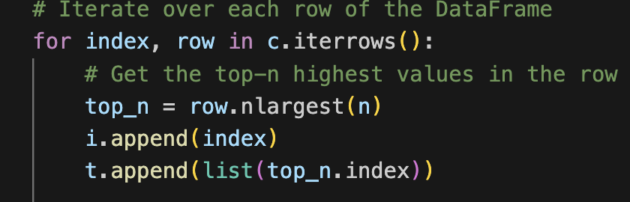
Pandas Data Manipulation
2. To determine what county had the most cases of each type of cancer:
*index of df is type of cancer*
*Column names are counties*
Iterrows(): iterates over each row in df
Nlargest(n): grabs the column name and
value of the top 'n' values in a row
Used Groupby again to get the number of times each county was the top county

Slide 18
Results Analysis
3

Slide 19
United States Results

Slide 20
United States Analysis
Approximately 1,958,330 cases of cancer
California leads, with 192,770 cases.
In the 5-year span, US' female breast cancer leads with 297,790 cases
Prostate cancer next, with 288,300 cases.
Uterine cervix, and uterine corpus were least prevalent with 65,000 cases per year.
Four most populated states
California
Texas
New York
Florida

Slide 21
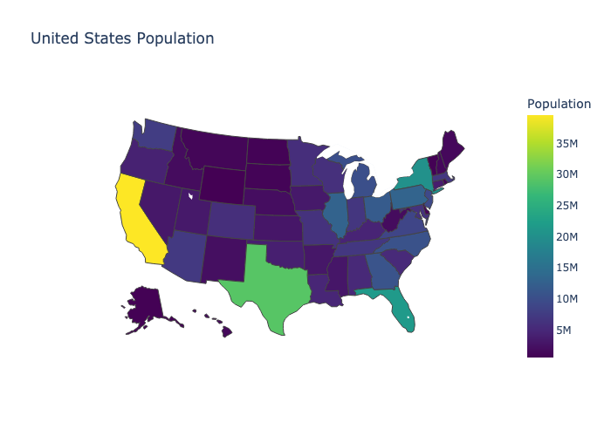
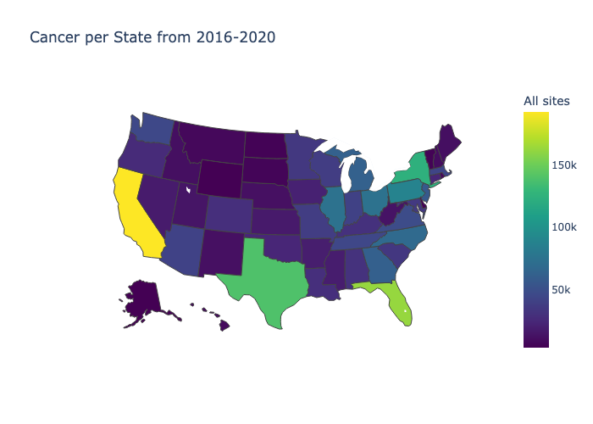
For this Project, we chose to analyze New York and Florida
United States Population Heatmap
Cancer per State Heatmap
Notes:
Excel sheet, and links

Slide 22
New York Results

Slide 23
New York Analysis
New York average population was 19.66 million, between 2016-2020.
In the five-year period, New York had 13,944 cases of cancer.
5 Boroughs, Nassau and Suffolk in ten top for population and cancer, with Brooklyn leading both
Most Prevalent: Lung and Bronchus
Least Prevalent: Hodgkin Lymphoma

Slide 24
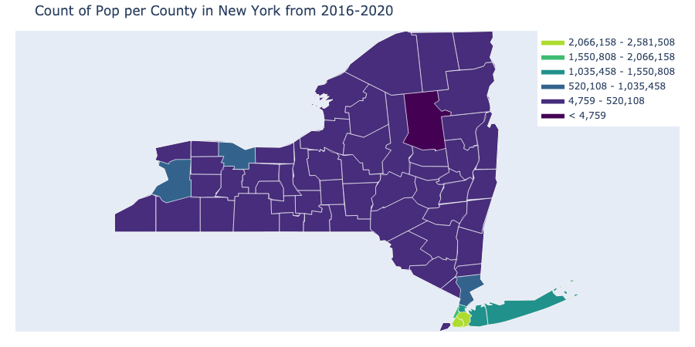
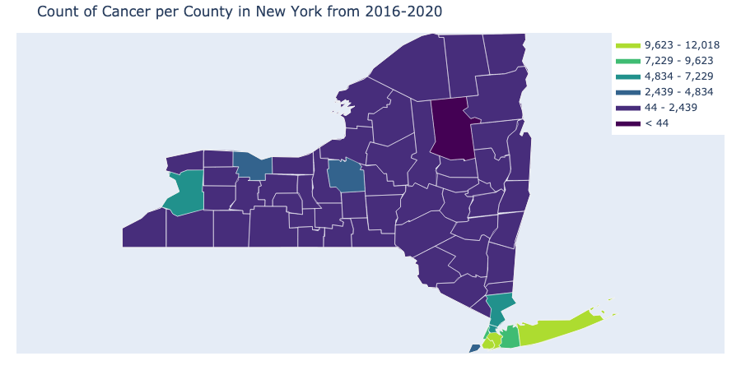
New York Heatmaps
New York Population Heatmap
Cancer per County Heatmap

Slide 25
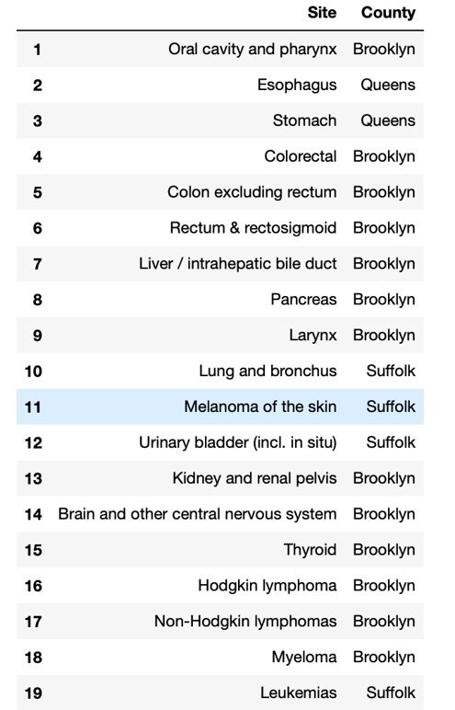
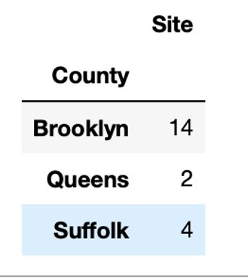
New York Analysis
Highest Populations: Queens and Brooklyn
Brooklyn had the largest number of cancer cases in 14 different types of cancer.
Suffolk's Four Types:
Bladder, lung, melanoma, and leukemia.

Slide 26
Melanoma in Suffolk County
Melanoma is typically from UV radiation exposure
More common in fair-skinned people
Suffolk County's population is 82.8% Caucasian
Suffolk has over 20 beaches.

Slide 27
Bladder, Leukemia, and Lung Cancer in Suffolk
Several factors for bladder, leukemia, and lung cancer are: ​
Smoking
Pollution
Exposure to specific chemicals

Slide 28
Bladder, Leukemia, and Lung Cancer in Suffolk…
In 2018, Centereach, Farmingville, and Selden had higher cancer incidences of bladder, lung, and leukemia.
Leukemia 51% higher, Thyroid 46% higher, Lung 40% higher, Urinary bladder 30% higher
2021: Suffolk County used approximately 6.5 million pounds of pesticides.​
Counties typically use less than 100,000 pounds. ​​

Slide 29
Florida Results

Slide 30
Florida Analysis
67 Counties
Average population: 21.21 million
Miami-Dade leads with cases, totaling 66,000
Broward and Palm Beach have 45,000 cases each
650,000 cases of cancer from 2016-2020
Most Prevalent: Bronchus and Breast
Least prevalent: Cervix

Slide 31
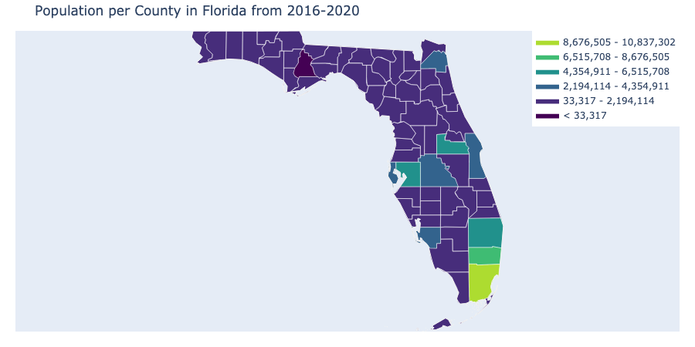
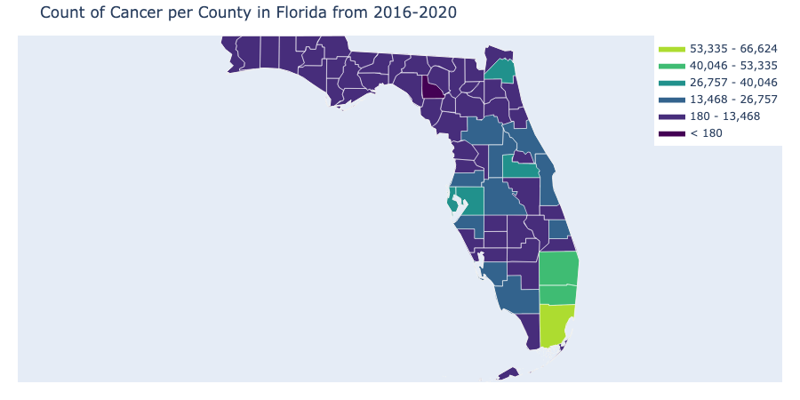
Florida Heatmaps
Florida Population Heatmap
Cancer per County Heatmap

Slide 32
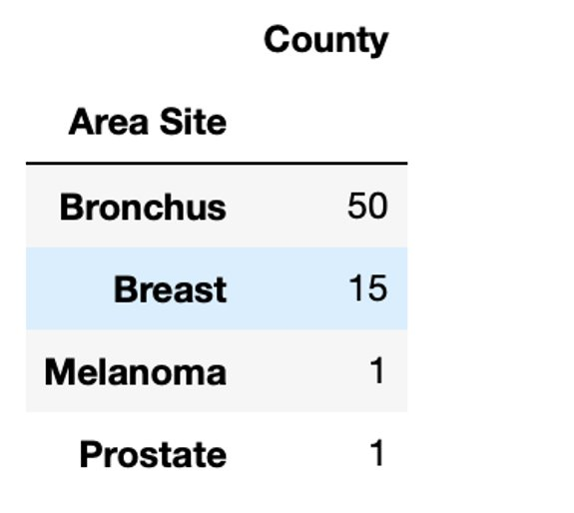
Most Prevalent Cancer by County
The most prevalent type of Cancer in 50 Counties in Florida is Bronchus
The most prevalent type of Cancer in 15 Counties in Florida is Breast
Melanoma and Prostate were most prevalent in 1 county each

Slide 33
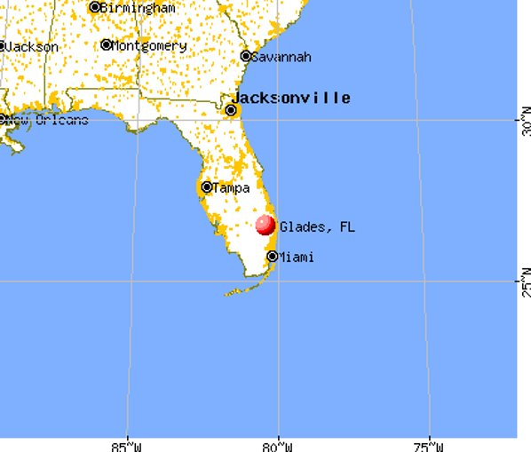
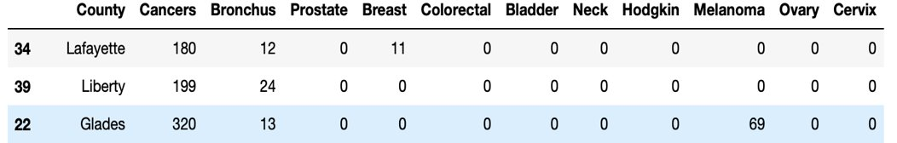
Melanoma
The county where Melanoma is most prevalent is Glades
Glades is the third smallest out of 67 counties both in population and in incidences of cancer
Glades is in southern Florida which explains why the Melanoma rate is so high compared to the rest

Slide 34
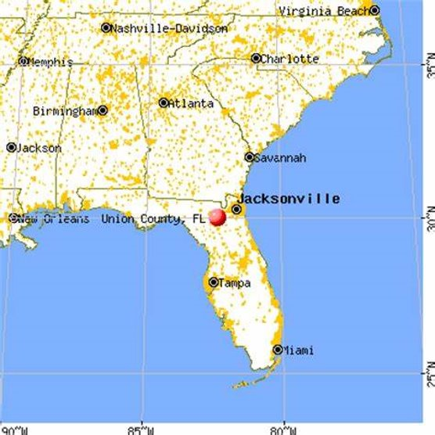
Prostate
The county where Prostate Cancer is most prevalent is Union.
Union County is in the bottom third of counties with cancer prevalence.
While the other counties with a predominantly male population have a 100 to 97 male to female ratio, Union county has an estimated 183 to 100 male to female ratio.

Slide 35
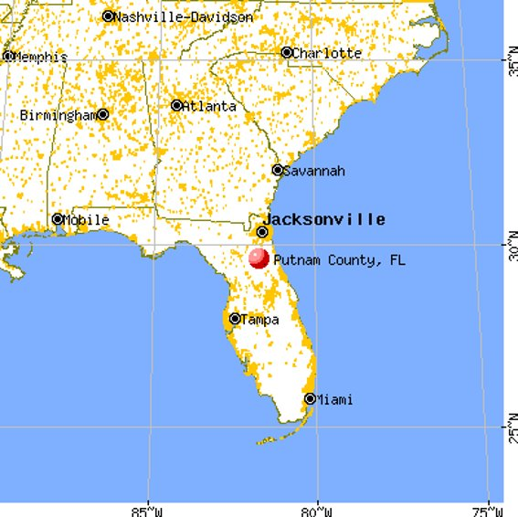
Bronchus
Bronchus is most prevalent cancer across 50 counties.
Florida has a 14.5% smoking rate.
Smoking heavily skews toward the older population.
Florida has a large retirement population.
Specifically, Putnam County has a smoking rate of 25%
Lack of Screening: while national screening rate is 4.5, Florida’s falls to 2.4%

Slide 36
Breast
15 Counties out of 67 have Breast as most prevalent.
14/15 Counties have a higher female : male ratio
Sumter is the one county out of the 15 with a higher male : female ratio
Why is Breast Higher than Bronchus or Prostate in Sumter County?

Slide 37
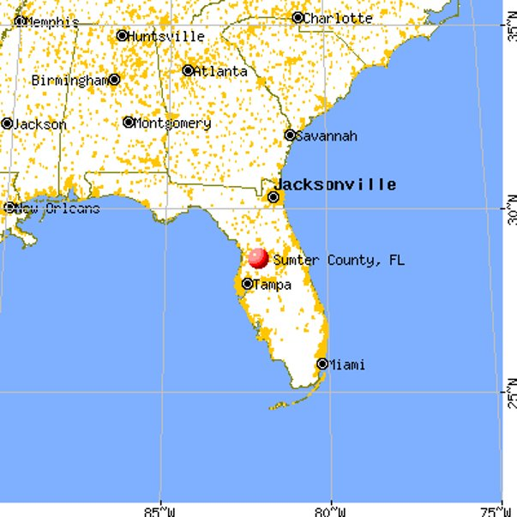
Sumter County…
Oldest county in United States​
Has been (on numerous accounts) ranked best in state for smoking​
Lowest recorded smoking rate of 12%

Slide 38
4
Conclusion

Slide 39
Three Major Takeaways
Data science is a growing field that is essential in any field of work, as it provides clear insights to the person doing the job in a quicker and more effective way
By using data science to analyze large datasets, we can easily and quickly identify patterns of cancer occurrence and prevalence in relation to demographic, lifestyle, and environmental factors.
Visualizations created using data science allows patterns and anomalies to be shown and connected, emphasizing the sharing and teaching of these key connections to a broader audience.

Slide 40
5
Citations

Slide 41
Citations
4
American Lung Association. “State of Lung Cancer: Florida.” State Data | Florida | American Lung Association, www.lung.org/research/state-of-lung-cancer/states/florida#:~:text=Screening%20for%20High%20Risk%3A,the%20national%20rate%20of%204.5%25. Accessed 28 Nov. 2023.
Bureau, US Census. “County Population Totals: 2010-2019.” Census.Gov, 29 Mar. 2023, www.census.gov/data/datasets/time-series/demo/popest/2010s-counties-total.html.
Cancer Incidence and Mortality by County, New York State, www.health.ny.gov/statistics/cancer/registry/pdf/volume1.pdf. Accessed 29 Nov. 2023.
Cronin, Patrick. “How Data Science Is Helping Oncologists Battle Cancer.” Health IT Answers, 27 Apr. 2023, www.healthitanswers.net/how-data-science-is-helping-oncologists-battle-cancer/.
“Department of Health.” Average Annual Population of Counties, New York State, 2016-2020, www.health.ny.gov/statistics/cancer/registry/appendix/countypop.htm. Accessed 28 Nov. 2023.
Gangemi, Christopher. “Dubious Distinction for Suffolk; It Leads the State in Pesticide Use.” Dubious Distinction for Suffolk; It Leads the State in Pesticide Use | The East Hampton Star, www.easthamptonstar.com/government/202346/suffolk-leads-state-pesticide-use. Accessed 28 Nov. 2023.
“Getting Started with Plotly.” Plotly.com, plotly.com/python/getting-started/.
www.ncbi.nlm.nih.gov/pmc/articles/PMC10312208/.

Slide 42
Citations Continued
“Florida Statewide Cancer Registry.” The Florida Cancer Data System - Publications, fcds.med.miami.edu/inc/publications.shtml. Accessed 28 Nov. 2023.
National Library of Medicine. (n.d.). What increases your risk of melanoma? - informedhealth.org - NCBI bookshelf. https://www.ncbi.nlm.nih.gov/books/NBK321118/
Sheridan, Terry. “Elevated Cancer Rates in 3 Suffolk Towns Prompt Study.” WSHU, 19 Oct. 2021, www.wshu.org/news/2018-07-19/elevated-cancer-rates-in-3-suffolk-towns-prompt-study.
Siegel, Rebecca L, Kimberly D Miller, Nikita Sandeep Wegel, et al. Cancer Statistics, 2023 - Siegel - Wiley Online Library, Acs Journals, acsjournals.onlinelibrary.wiley.com/doi/full/10.3322/caac.21763. Accessed 29 Nov. 2023.
Sivaram, Sudha, et al. “Building Capacity for Global Cancer Research: Existing Opportunities and Future Directions.” Journal of Cancer Education : The Official Journal of the American Association for Cancer Education, U.S. National Library of Medicine, July 2021, www.ncbi.nlm.nih.gov/pmc/articles/PMC8285681/.
Naples Center for Functional Medicine .Surviving Florida’s never-ending summer sun. Naples Center for Functional Medicine. (2023, October 23). https://naplescfm.com/uncategorized/surviving-floridas-never-ending-summer-sun/#:~:text=Southwest%20Florida%20often%20reaches%20an,skin%20is%20to%20stay%20indoors.
“Playwright Library.” Playwright, playwright.dev/docs/api/class-playwright. Accessed 1 Dec. 2023.
“United States Census, 2020.” Ballotpedia, ballotpedia.org/United_States_census,_2020. Accessed 28 Nov. 2023.
“UV Index Overview | US EPA - U.S. Environmental Protection Agency.” United States Environmental Protection Agency, www.epa.gov/enviro/uv-index-overview. Accessed 29 Nov. 2023.
23,

Slide 43
Any Questions?

